Slide 1
What are Blood Tests?
Your Health in a Drop!
Praveena Kuchipudi

Slide 2
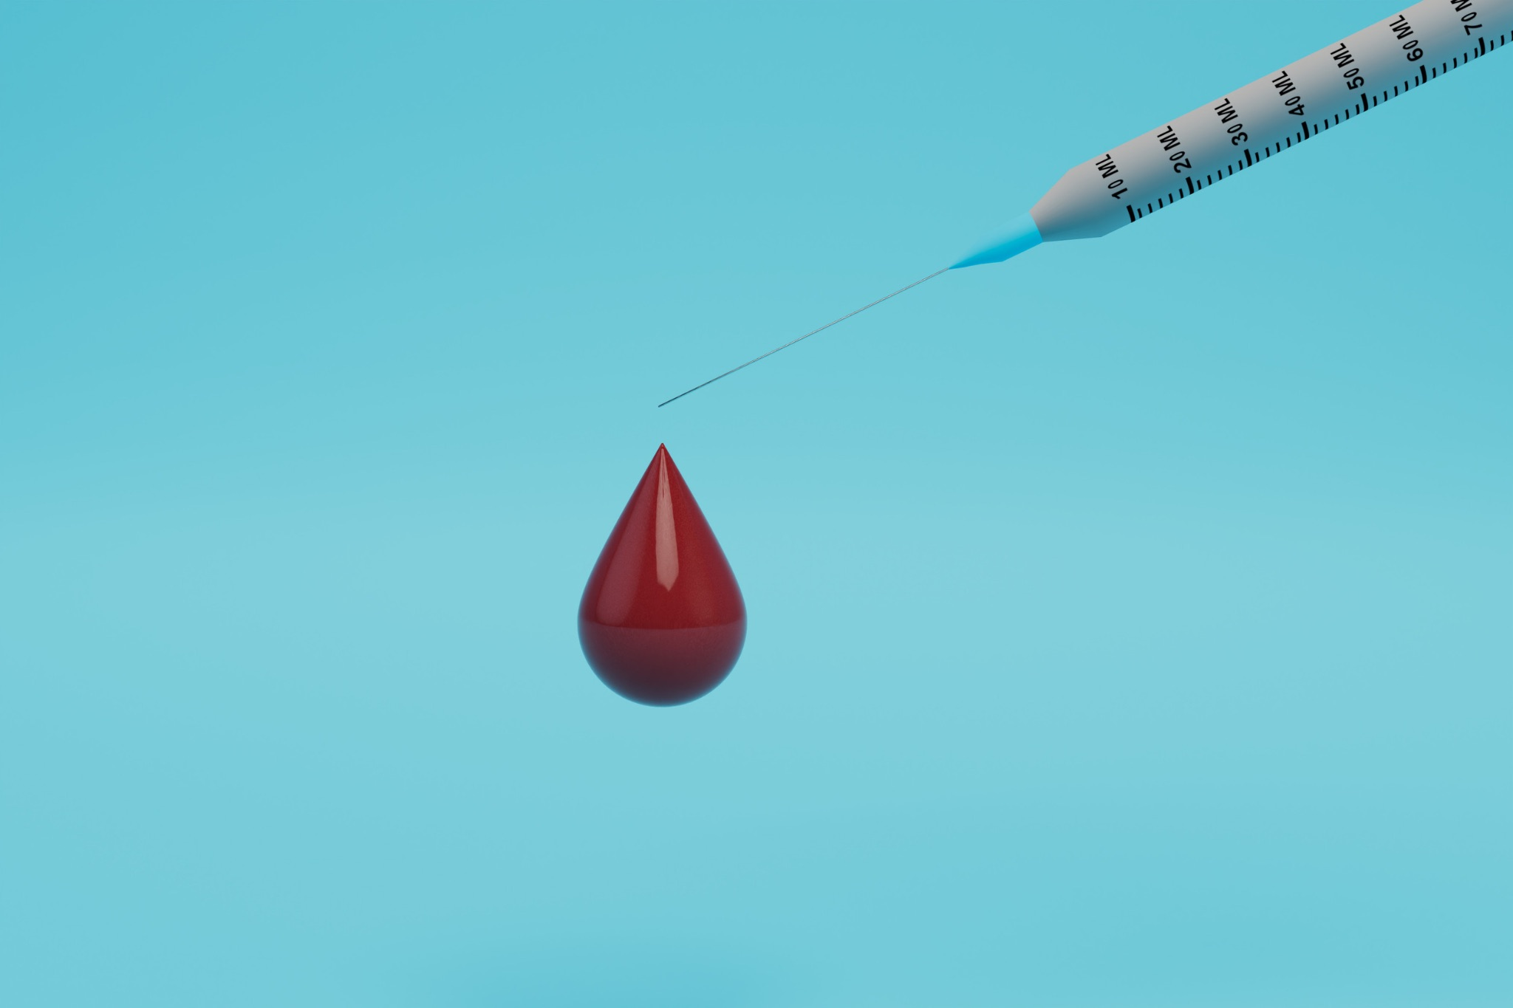
Introduction - The Power of a Drop
What if a tiny drop of blood could tell us a whole story about your health?
Blood tests are laboratory analyses of a blood sample
Crucial for diagnosis, monitoring, and overall health assessment
Notes:
Imagine, a seemingly insignificant drop, holding so much vital information. Today, we're going to unlock the secrets within that drop.
In essence, we take a small sample of your blood, and then specialized equipment and trained professionals examine its components.
This isn't just about looking at red or white, it's about diving deep into the microscopic world within.
Just like a snapshot captures a specific moment in time, a blood test gives us a precise reading of what's happening inside your body at that very moment.
Our bodies are complex systems, much like a constantly flowing river. A blood test helps us understand the 'current' of that river – its speed, its composition, and any obstacles it might be encountering.
So, why do we bother with this 'snapshot' of our internal river? Because the insights gained are incredibly valuable.
For diagnosis, blood tests can confirm suspicions, identify infections, or even detect early signs of serious diseases.
For monitoring, they allow doctors to see if a medication is working, if a condition is improving, or if it's getting worse, enabling them to adjust care as needed.
And for overall health assessment, they provide a baseline, helping you and your doctor proactively manage your health and identify any areas that might need attention, often before you even feel symptoms.

Slide 3
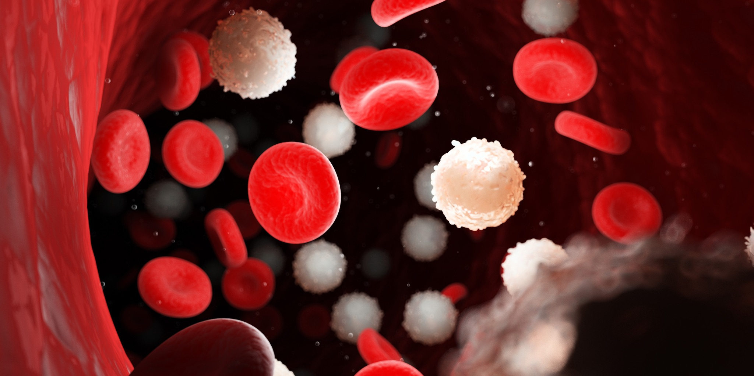
What is Blood?
Components of Blood
Plasma (liquid matrix)
Red Blood Cells (oxygen transport)
White Blood Cells (immune system)
Platelets (clotting)
Each component offers distinct health insights.
Notes:
"Now that we understand what a blood test is and why it's so important, let's dive into what makes up this incredible fluid that flows through our veins."
Let’s look at various components of blood and understand about each of them.
First, we have Plasma. Think of plasma as the 'liquid matrix' or the 'river itself' in our earlier analogy. It's the yellowish, watery part of your blood, making up over half of its volume. Plasma carries all sorts of vital things – nutrients, hormones, proteins, and waste products – transporting them throughout your body."
Next, we have Red Blood Cells, perhaps the most recognizable component. These tiny, biconcave discs are absolutely crucial for oxygen transport. They're packed with a protein called hemoglobin, which is what gives blood its red color, and their primary job is to pick up oxygen from your lungs and deliver it to every single cell in your body. Without enough healthy red blood cells, your body simply can't get the oxygen it needs to function.
Moving on, we have White Blood Cells. These are your body's unsung heroes, the crucial part of your immune system. Unlike red blood cells, they come in various shapes and sizes, and each type has a specific role in fighting off infections, diseases, and foreign invaders like bacteria and viruses. They are your body's internal defense force, constantly on patrol.
Finally, we have Platelets. These aren't full cells; they're tiny cell fragments, but they play a monumental role in blood clotting. When you get a cut or an injury, platelets rush to the scene, stick together, and help form a plug, preventing excessive bleeding. They are your body's natural bandages, essential for wound healing and preventing blood loss.
So, why is it important to know about these individual components?
Because each component offers distinct and vital health insights. A blood test doesn't just look at 'blood' as one thing; it meticulously analyzes these individual parts. By measuring the levels and characteristics of plasma, red blood cells, white blood cells, and platelets, doctors can gain incredibly detailed information about your health – detecting infections, assessing organ function, diagnosing blood disorders, and much more. They tell a unique part of your overall health story."

Slide 4
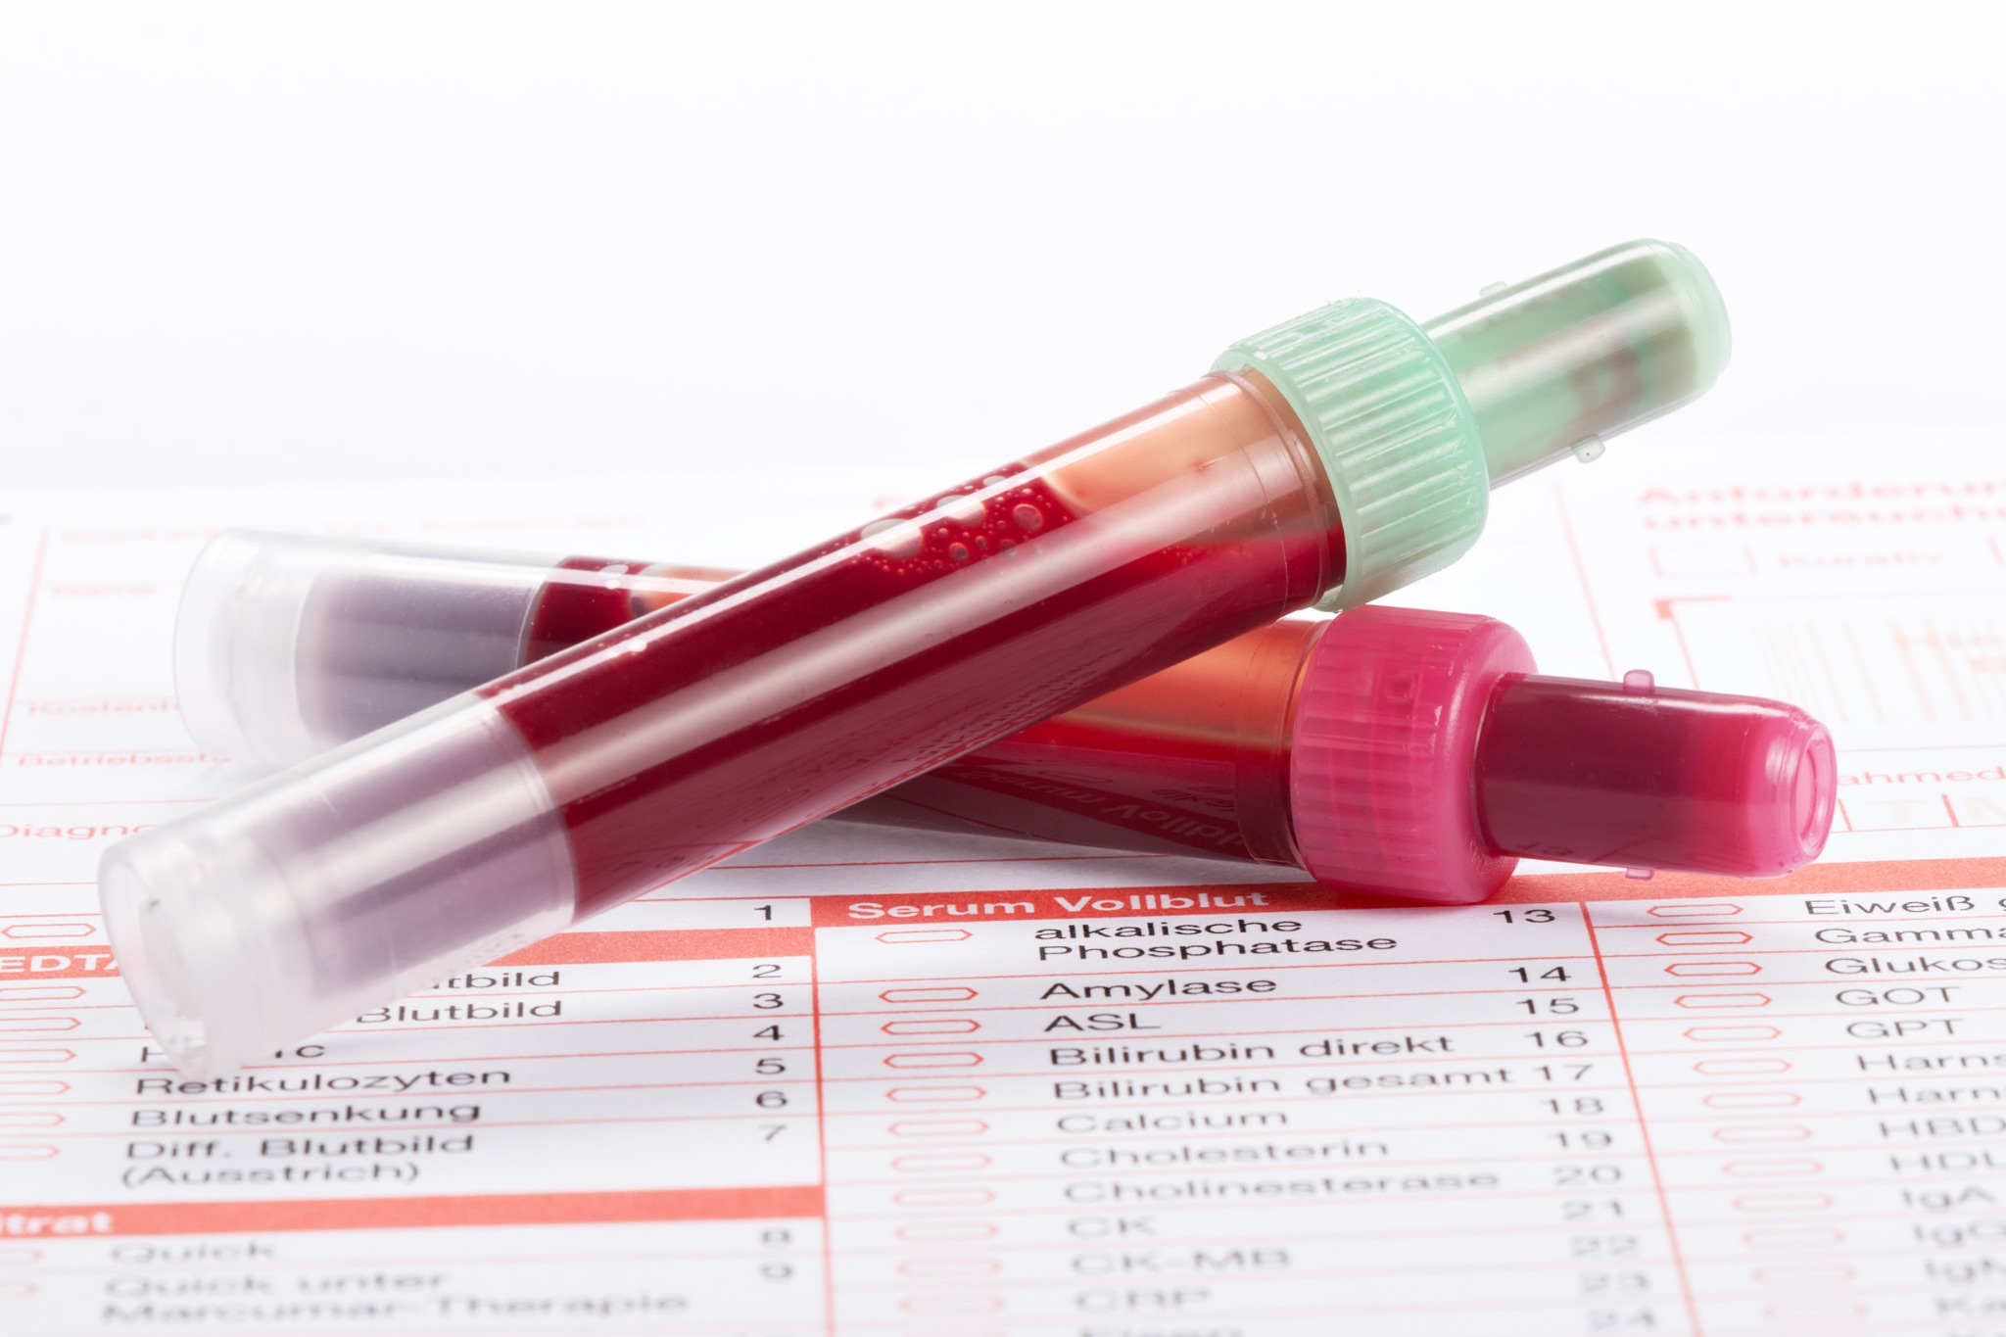
Why Are Blood Tests So Important?
Diagnostic Tool:
Detecting diseases (infections, anemia, diabetes, kidney/liver issues)
Identifying inflammation and nutrient deficiencies
Monitoring Health Conditions:
Tracking chronic diseases (e.g., diabetes, thyroid disorders)
Assessing treatment effectiveness
Assessing Organ Function:
Kidneys, Liver, Thyroid, Heart
General Health Check-up:
Baseline measurements for future comparison
Proactive identification of potential issues
Notes:
Now that we've understood what blood is made of, let's explore the incredible range of ways blood tests are used in healthcare. They're far more than just a routine poke; they're a versatile and powerful window into your body.
Firstly, blood tests are an indispensable Diagnostic Tool. If you're feeling unwell, blood tests can often provide crucial clues. They help doctors in:
Detecting diseases: This includes everything from common infections like bacterial or viral illnesses, to conditions like anemia (low red blood cell count), or metabolic disorders like diabetes. They can also indicate issues with vital organs like your kidneys or liver, helping to pinpoint the cause of symptoms.
Identifying inflammation: Blood tests can reveal markers of inflammation in your body, which can be indicative of many underlying conditions, from autoimmune diseases to chronic infections.
Spotting nutrient deficiencies: For example, tests can show if you're lacking essential vitamins like B12 or minerals like iron, which can impact your energy levels and overall health

Slide 5
Types of Blood Samples
Whole Blood
Blood collected with an anticoagulant, preventing it from clotting. Contains all blood components (red blood cells, white blood cells, platelets, plasma).
Uses: Complete Blood Count (CBC), blood typing, and some genetic tests.
Plasma
The liquid portion of blood after anticoagulation and centrifugation, which separates the cellular components from the fluid. Contains clotting factors.
Centrifugation is a laboratory technique used to separate components of a mixture (eg: blood cells, urine, cell components) .
Uses: Coagulation studies (e.g., prothrombin time (PT), partial thromboplastin time (PTT)), some drug levels, some protein assays.
Serum
The liquid portion of blood after it has clotted and the clot has been removed (by centrifugation). Lacks clotting factors (coagulation factors.
Clotting factors are a group of proteins in the blood that work to stop the bleeding and form a blood clot.
Uses: Most chemistry tests (e.g., electrolytes, glucose, kidney/liver function), hormone tests, antibody tests, tumor markers.

Slide 6
Blood Tests based on Category
Metabolic Tests
Fasting Blood Glucose
Measures blood sugar levels after an overnight fast
Screening for diabetes and prediabetes
HbA1c (Glycated Hemoglobin)
Provides an average of blood sugar levels over the past 2-3 months
Used for diabetes diagnosis and management
Lipid Panel
Measures cholesterol (total cholesterol, VLDL, LDL, HDL) and triglycerides, assessing cardiovascular risk
Electrolyte Panel (Na, K, Cl, CO2)
Measures key electrolytes crucial for fluid balance, nerve, and muscle function
Uric Acid
Evaluates for gout or kidney stone risk

Slide 7
Blood Tests based on Category
Inflammatory Tests
C-Reactive Protein (CRP)
A general marker of inflammation in the body
Erythrocyte Sedimentation Rate (ESR)
A general indicator of inflammation or infection
Procalcitonin
Used to assess the risk of developing systemic bacterial infection or sepsis

Slide 8
Blood Tests based on Category
Hormonal Tests
Thyroid Stimulating Hormone (TSH)
Screens for thyroid disorders (hypothyroidism or hyperthyroidism)
Thyroid Hormones (T3, T4)
Measures the actual thyroid hormones
Vitamin D
A crucial hormone/vitamin measured to assess bone health and immune function
Testosterone (Male/Female)
Evaluates reproductive and overall health
Estrogen/Progesterone (Female)
Assess menstrual cycle and reproductive health
Cortisol
Assess adrenal gland function and stress response

Slide 9
Blood Tests based on Category
Organ-Specific Tests
Kidney Function
Creatinine – A waste product, indicates kidney filtration
Blood Urea Nitrogen (BUN) – Another waste product, indicates kidney function and hydration
Liver Function Test (Liver Panel)
Alanine Aminotransferase (ALT)/Aspartate Aminotransferase (AST) – indicates liver cell damage.
Alkaline Phosphatase (ALP)/Gamma-Glutamyl Transferase (GGT) – indicates bile duct issues /liver cell damage
Cardiac/Heart
Troponin – Specific marker for heart muscle damage, used in suspected heart attacks
Brain Natriuretic Peptic (BNP) – Assesses heart failure
Pancreatic
Amylase / Lipase – enzymes used to diagnose pancreatitis

Slide 10
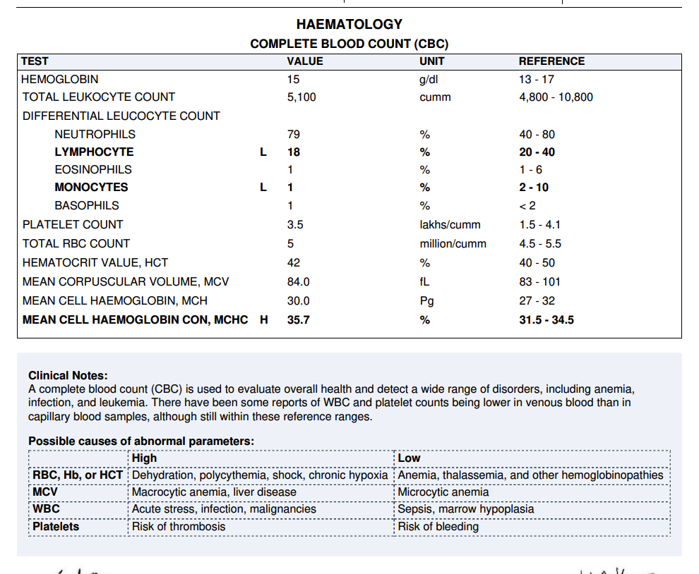
Common Blood Tests – Deep Dive 1
Complete Blood Count (CBC)
What it measures: Red blood cells, white blood cells, platelets.
What it indicates: Anemia, infection, inflammation, clotting issues, and some blood cancers.

Slide 11
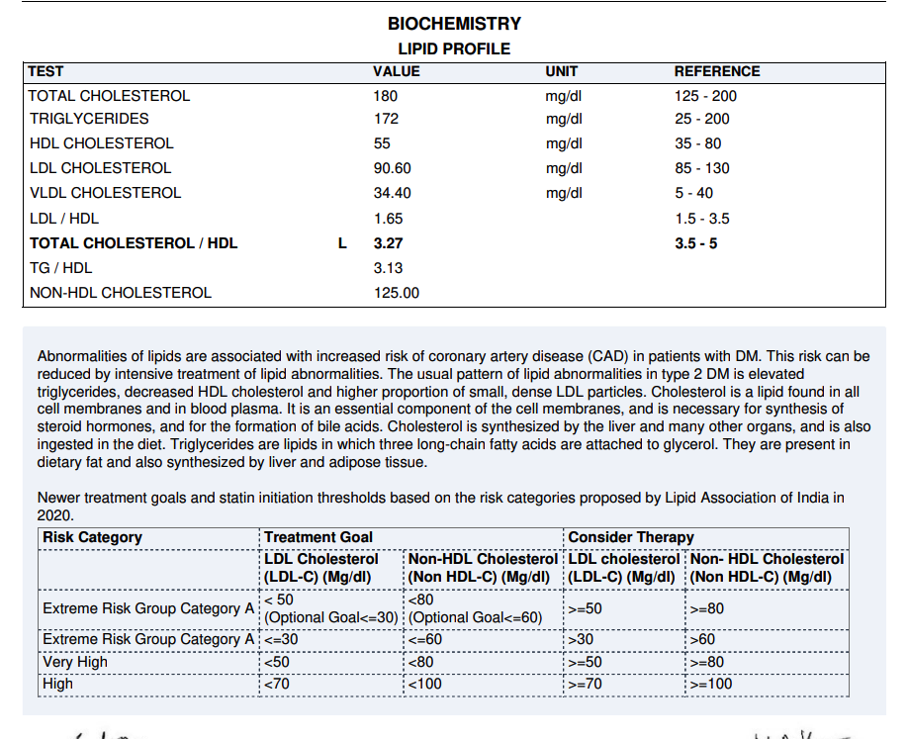
Common Blood Tests – Deep Dive 2
Lipid Panel
What it measures: Total Cholesterol, VLDL, LDL ("bad"), HDL ("good"), Triglycerides.
What it indicates: Risk of heart disease, atherosclerosis.

Slide 12
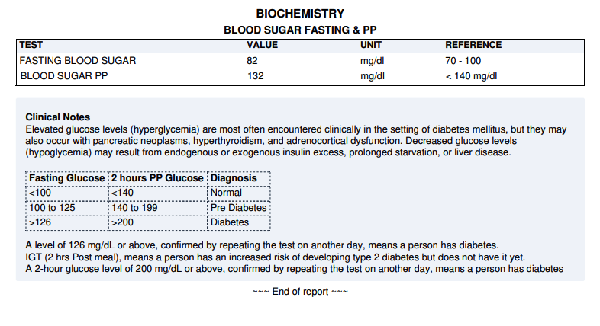
Common Blood Tests – Deep Dive 3
Blood Glucose Test/Diabetic Panel
What it measures: Sugar (glucose) in blood.
What it indicates: Diabetes, pre-diabetes, hypoglycemia.
Test parameters,
Fasting Blood Glucose – measured overnight fasting of 9-10 hours.
Post Prandial Blood Glucose - measured 2 hours post-meal ingestion

Slide 13
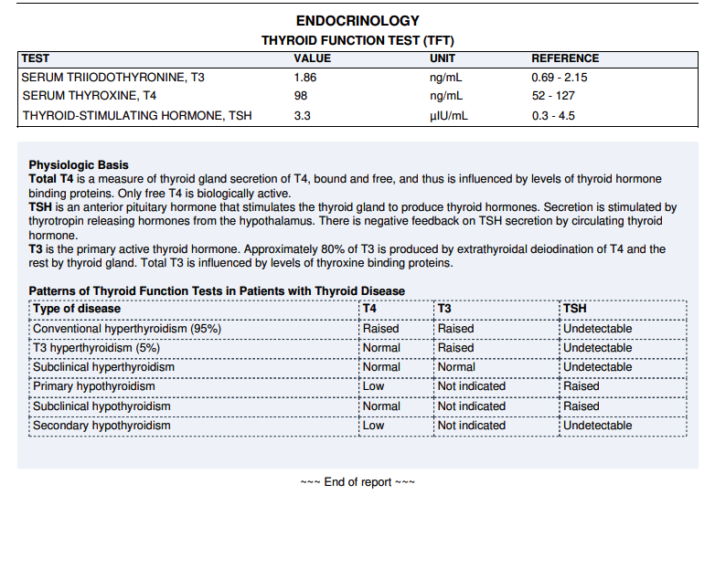
Common Blood Tests – Deep Dive 4
Thyroid Function Test
What it measures: Thyroid hormones (TSH, T3, T4).
What it indicates: Hypothyroidism, Hyperthyroidism, thyroid disorders.

Slide 14
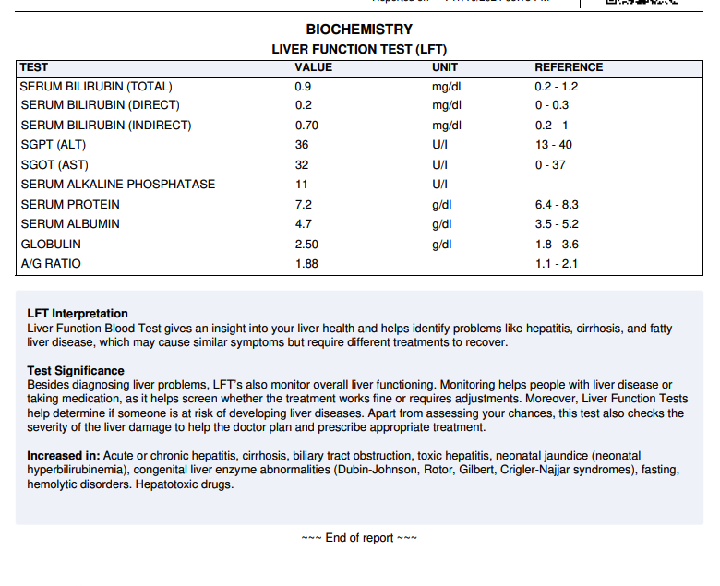
Common Blood Tests – Deep Dive 5
Liver Function Test
What it measures: Liver enzymes (ALT, AST, ALP), Bilirubin, Proteins.
What it indicates: Liver damage, inflammation, disease (e.g., hepatitis, cirrhosis).

Slide 15
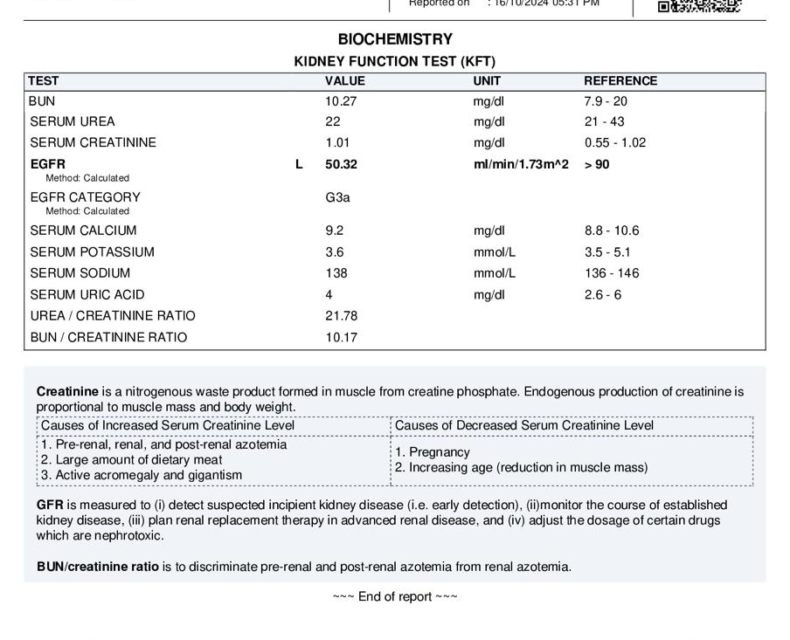
Common Blood Tests – Deep Dive 6
Kidney Function Test
What it measures: Creatinine, Urea Nitrogen (BUN), GFR.
What it indicates: Kidney efficiency, kidney disease

Slide 16
Understanding The Results
Laboratory Analysis: Samples are processed in specialized laboratories.
Reference Ranges: "Normal" vs "Abnormal" values.
Interpretation by Doctor:
Results are part of a larger picture (symptoms, medical history).
Not just a number – context is key.
They need to be understood in relation to the overall health situation.
Don't hesitate to seek clarification from the doctor

Slide 17
Takeaways
Blood tests are a fundamental tool in modern healthcare.
They provide vital insights into the body's functioning.
Early detection and monitoring are crucial for achieving better health outcomes.
Always discuss the results and any concerns with the healthcare provider.
Be proactive about your health!

Slide 19
Resources/References
Sample report formats sourced from https://www.labsmartlis.com/
https://medlineplus.gov/lab-tests/

